Slide 1
Preliminary study For Saudi footwear standardization
Done by :
Bandar AL-Ghamdi & Qassem A. AL-Akkam
Supervised by :
Dr. Mohamed T.Ibrahim El-Wakad

Slide 2
Dedication
We dedicate this project to :
Our parents
Our Doctors
Colleagues who will graduate with us

Slide 3
Acknowledgement
We indebted to our project supervisor:
Dr. Mohamed T.Ibrahim El-Wakad
For his helping and supplying us with his information and experience for his kindness with us.

Slide 4
Contents
Introduction
Review
Foot shape
Halux valgus
Objective
Method
Foot shape
Halux angle
Results
Conclusion

Slide 5
Introduction
The health of the foot depends to a great extent on the design of the shoes
The design of the shoes depend on the shape of the foot
Failing to wear comfortable shoes may lead to foot deformity(e.g. hallux valgus)

Slide 6
Introduction
The purpose of this study to:
classify the foot shape Saudi population
determining the existence of Hallux valgus foot deformity in Saudi population and it's percentage

Slide 7
Review
Review
Foot shape
Halux valgus

Slide 8
1.Foot shape:
Knowledge of foot shape is important to design shoes which fit properly.
Differences between genders, age, ethnic origin can also influence foot shape

Slide 9
2. Halux valgus:
2.1. What is Hallux valgus?
The term hallux valgus (bunion) actually describes what happens to the big toe. The big toe tilts over towards the smaller toes and a bony lump appears on the inside of the foot.

Slide 10
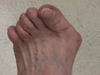
Figures 1 show how hallux valgus (bunion) looks like
2. Halux valgus:
Figures.1

Slide 11
2. Halux valgus:
2.2. Occurrence of Hallux valgus:
According to the National Health Interview survey conducted by the National Center for Health Statistics
scientists report found that the incidence increased with age, with rates of
3% in persons aged 15-30 years
9% in persons aged 31-60 years
16% in those older than 60 years.

Slide 12
2. Halux valgus:
2.2. Occurrence of Hallux valgus:
Also in the report a higher incidence in females versus males, with ratio of 2:1 to 4:1.
Other scientists also note that hallux valgus rarely occurs in those who only wear sandals and other types of shoe gear that keep the first and second toes separated.
The role of genetic predisposition has also been noted. The connection may be that bunions are a bit commoner in people with unusually flexible joints, and this can be hereditary.

Slide 13
2. Halux valgus:
2.3. Prevention
making sure that the toe of your shoe is wide enough
Prevention
using soft insoles in your shoes as shock absorbers
soaking and scrubbing your feet when you are in the bath or shower.
Not wearing high-heeled shoes too often
making sure your shoes are not too tight

Slide 14
Objective
Objective
To Classify in order to come up with foot standard
To determine of hallux valgus problem in Saudi population.

Slide 15
Method
Two groups of males and females, Each group consists of 50 subjects.
Male group ranged between 17 to 83 with a mean age of 48.
Female's group age ranged from19 to 74. The mean age of females group was 50.

Slide 16
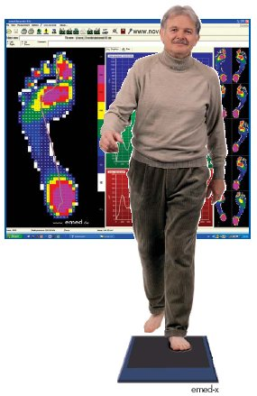
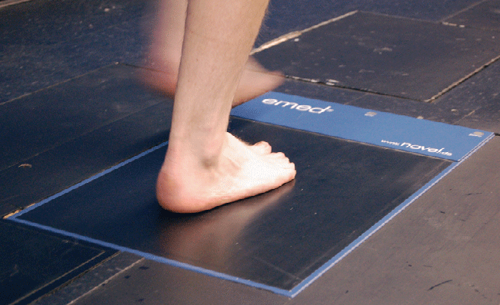
Method
Novel Emed-n platform (Munich,Germany) See figures
The parameters measured by machine are: foot length, foot width, and hallux angle.

Slide 17
Method
Foot index:
The foot shape was classified according to the foot index (FI), defined as:
Slender if its FI < [(mean FI) – SD]
Broad if its FI > [(mean FI) + SD]
Standard otherwise.

Slide 18
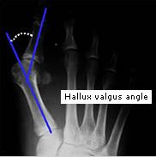
Method
2. Halux angle:
(fig.2)
The range of normal values for hallux angle is between 0° and 30°.

Slide 19
Method
Metatarsus-phalanx angle (MPA)
MPA = 180° – Hallux angle
The foot is considered deformed if its MPA < 165
Normal otherwise.

Slide 20
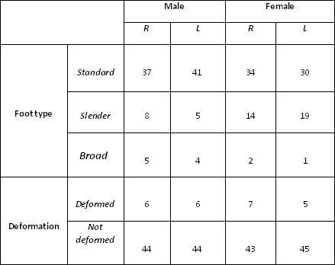
Results
Table1

Slide 21
Foot Type
Male
female

Slide 22
Deformation
Male
female

Slide 23
Conclusion
A significant percentage of male and female Saudi population can be classified to have standard feet (>73%)
Broad feet are the least percentage (2 – 14 %) in Saudi population.
In both male and female population more than 85% can be classified to have normal feet.
Deformation of Saudi population feet is less than their Korean one which may be attributed to the different working habits and style of life.
This study needs to be expanded to cover larger sample size to be able to set shoe standards for Saudi population.
We cannot make the same standard for both male and female due to the differences in gender, age and environment.

Slide 24
Thank You !

