Slide 1
Graduation Project
BMT 468
Separation of Heart and Respiration signals using MATLAB
Dr. Ali Saad : Under supervision of

Slide 2
Content
1. Introduction
2. Methodology
3. Results
4. Conclusion

Slide 3
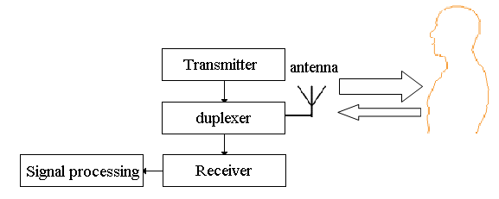
:Principle of the system Radar motion sensing systems
:Radar Introduction Definition

Slide 4
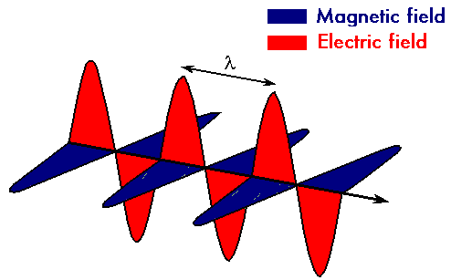
Electromagnetic Waves:
Definition
Microwaves:
Definition

Slide 5
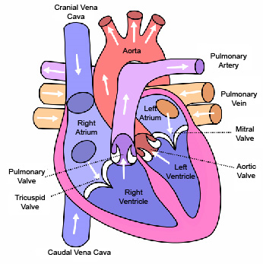
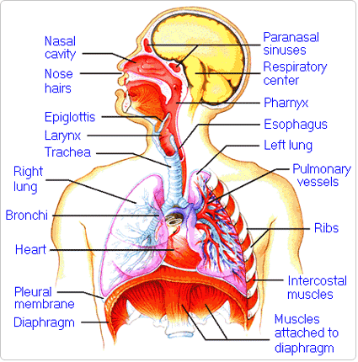
:Cardiac system Physiology and measurement
Respiratory system
Physiology and measurement

Slide 6
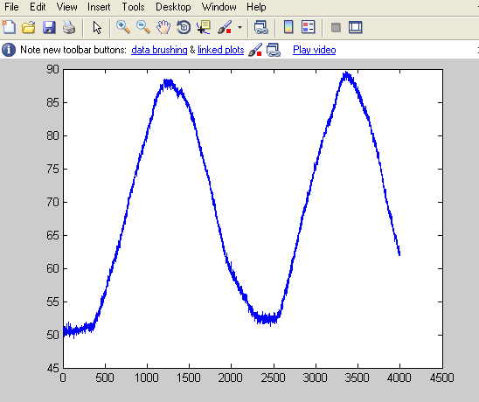
Separation of heart beat and breathing

Slide 7
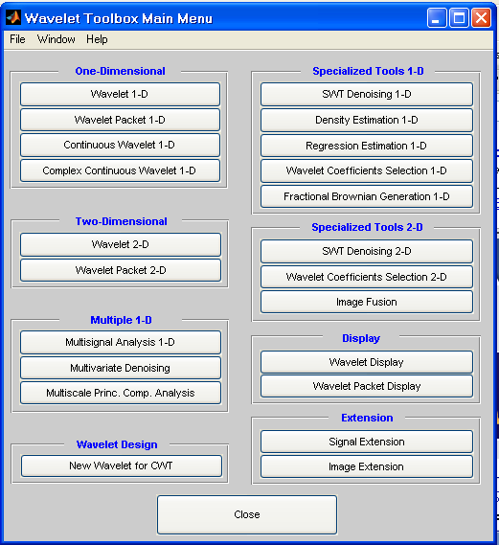
Methodology:
? Why we using MATLAB 1-
MATLAB provide DSP algorithm designers, system architects, and embedded hardware and software engineers with a comprehensive set of tools that address the challenges of shortened design cycles for systems with increasing complexity. With MATLAB , you can:
Develop digital signal processing (DSP) algorithms
Model and simulate systems
Verify and validate your hardware and software implementations

Slide 8
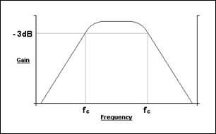
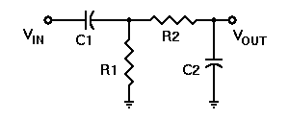
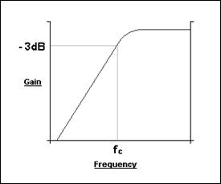
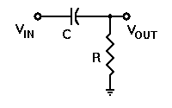
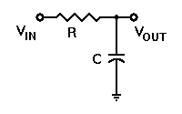
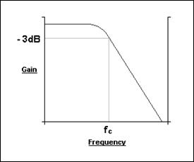
2-Filters theory
Band-pass filter
High-pass filter
Low-pass filter

Slide 9
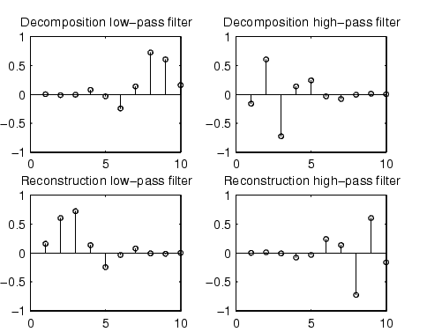
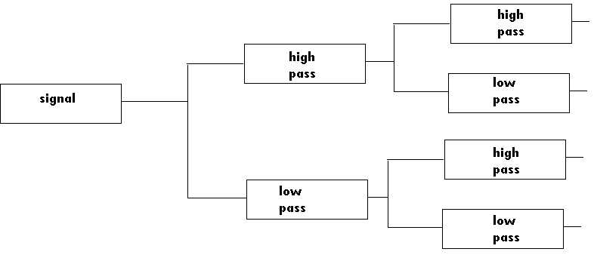
Wavelets methods for separation
Description
Description
Daubechies wavelets
Biorthogonal wavelet
Wavelets decomposition theory
Description

Slide 10
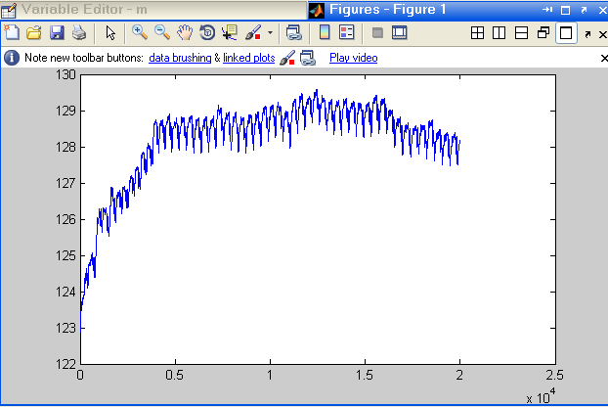
Results
1- Heart signal without respiration

Slide 11
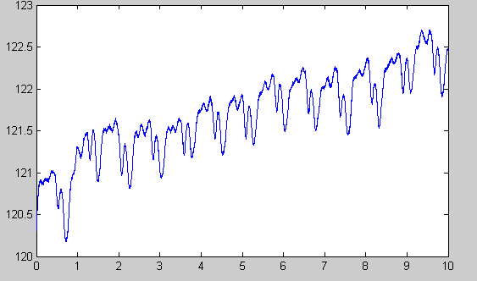
Signal cutting up to 10 seconds
Applies data into low pass filter to make it look like Sine wave to determine number of peaks in 10 second which will be the heart rate in 10 second after that we can calculate heart rate in one minute.

Slide 12
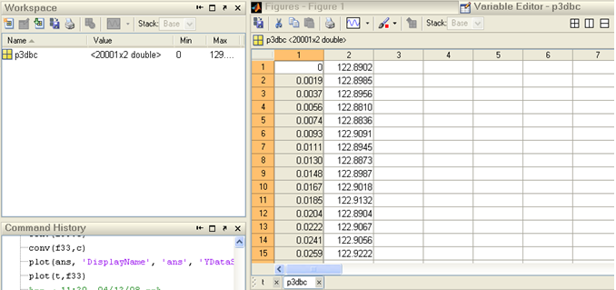
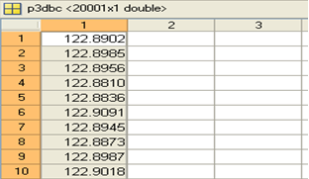
Steps
load c:\p3dbc.prn
Then we delete the first column which is the time

Slide 13
Save it in text file.
Name it .
Open it as workspace.
t=0:10/4864:10
s=t'
Plot(s,f3)

Slide 14
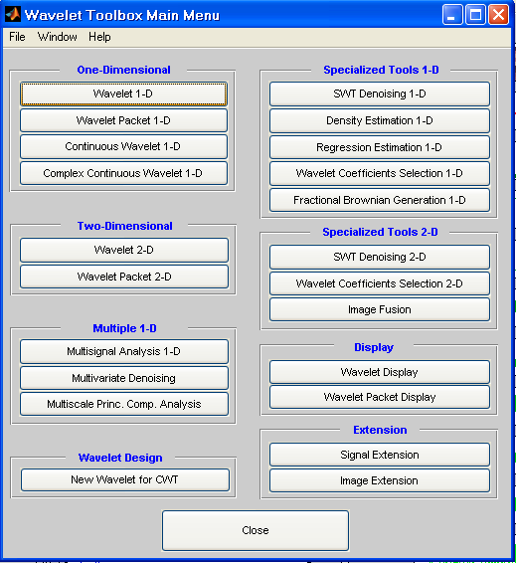
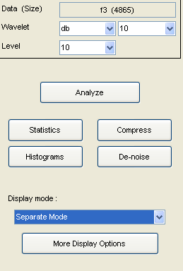
Applied this wave to low and high bass filter to count number of pulses per minute by:
1-Save f3 as .mat file
2-Opining wave menu in Matlab
3-Choosing wavelet 1-D
4-Load the signal
5-Choosing db with 10 levels

Slide 15
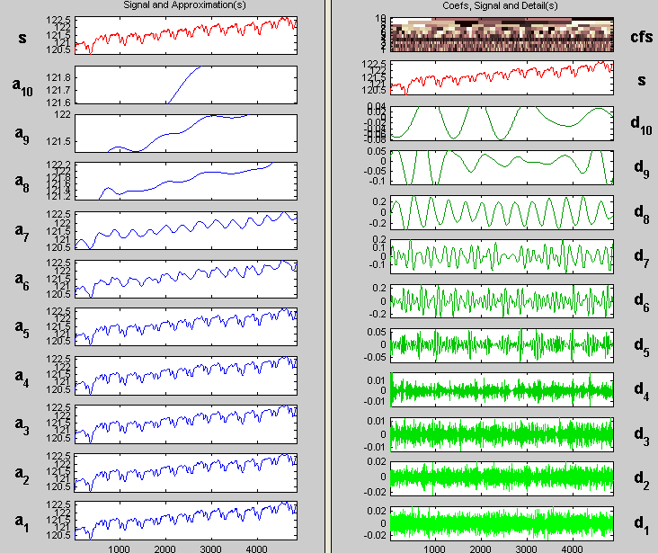
Counting number of peaks in d8
Number of peaks in d8 =heart pulse rate in 10 second=13pulses
Number of pulses in one minute = 13*60/10=78 BPM

Slide 16
2- Heart and respiration signal

Slide 17
Using db wavelet to separate the two signals

Slide 18
Respiration signal
No. of peaks = 2 in 10 second
In one minute = 60*2/10=12bpm (respiratory rate)
Heart signal
No. of peaks = 11 in 10 second
In one minute = 60*11/10=66bpm (heart rate)

Slide 19
Conclusion
This project provided us a good experience in signal processing on real biomedical signals. We also gain some experience in using Matlab signal processing package for this purpose. It also, introduces wavelets decomposition and wavelets techniques for signal processing issues.
After many research in the Internet, we have a good and clear background on the operations that we can do on signals. We also hope that in the future, we will be among those people who trait such scientific issues.

Slide 20
Thank you
THE END

